Slide 1
Understanding Convolutional Neural Networks (CNNs)
ANTHONY EDDEI KWOFIE
MSc Artificial Intelligence And Data Science – University of Hull
30 October 2025

Slide 2
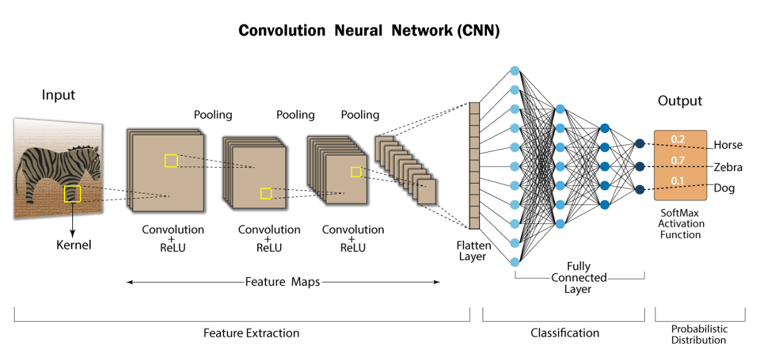
What is a CNN?
CNN structure diagram
CNNs are deep learning models built to analyse visual data or images.
Convolution layers identify simple visual patterns such as edges and textures.
Pooling layers reduce data size while keeping key information.
Fully connected layers turn those features into predictions.

Slide 3
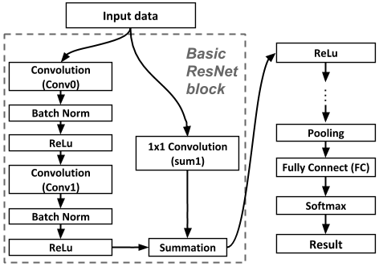
Case Study: Deep Residual Learning
Paper: He, K., Zhang, X., Ren, S., & Sun, J. (2015)
Deep Residual Learning for Image Recognition.
Available at: https://go.exlibris.link/1hvjCCTL
Goal: Make deep CNNs easier to train.
Dataset: ImageNet (over 1 million images).
Model: ResNet (Residual Network).
Result: Achieved top performance with 96% top-5 accuracy.
ResNet block diagram)

Slide 4
Why CNNs Were Suitable
Automatically extract image features.
Efficient with large datasets.
Reduce need for manual feature selection.

Slide 5
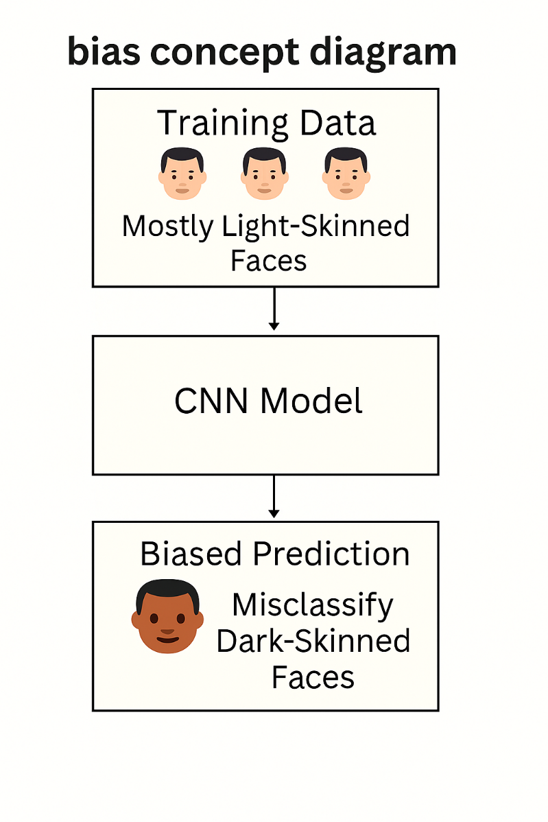
Ethical Issue: Bias in CNNs
Ethical Concern: Bias in facial recognition
Training data may not include all demographic groups equally.
Could result in unfair predictions.
Solution: Use diverse datasets and evaluate fairness.

Slide 6
Reflection
My CNN Experience
What? Built a CNN to classify MNIST digits.
How? Used Keras and experimented with layers.
Why? To understand how CNNs learn image patterns.
Outcome: Accuracy improved after tuning.
Next Step: Try more complex datasets.

Slide 7
Summary & References
Summary:
CNNs learn features from images using convolution and pooling layers.
ResNet helps train very deep networks using residual connections.
Ethical concern: bias in training data.
Reflection: practical experience improved understanding.

Slide 8
References:
He, K., Zhang, X., Ren, S. and Sun, J., 2015. Deep Residual Learning for Image Recognition. arXiv preprint arXiv:1512.03385. Available at: https://go.exlibris.link/1hvjCCTL [Accessed 13 October 2025].
Shivam. (2021) “Convolutional Neural Networks: Understand the Basics” [Diagram] . Analytics Vidhya. Available at: https://editor.analyticsvidhya.com/uploads/75059FC.png (Accessed: 24 October 2025).
He, K., Zhang, X., Ren, S. & Sun, J. (2015) “A building block of Residual Learning” [figure]. In: Deep Residual Learning for Image Recognition. Available at: https://www.researchgate.net/publication/328091629/figure/fig1/AS:678212644401153@1538709903556/Basic-block-diagram-of-ResNet.ppm (Accessed: 24 October 2025).

